Slide 1
Localization and Navigation Algorithms Continued

Slide 2
Localization and Navigation Algorithms
Fingerprint-based Localization
Localization by Acoustic Features
Localization by Lighting Features
Localization by Channel State Indicator (CSI)
Localization by Environment Features
Crowdsourcing and unsupervised learning
Crowdsourcing
Unsupervised learning

Slide 3
Fingerprint based Indoor localization
RSS Fingerprint
Magnetic force signature
Acoustic Features
Acoustic Background Features
Lighting Features
Channel State Indicator (CSI)
Other Environment Features

Slide 4
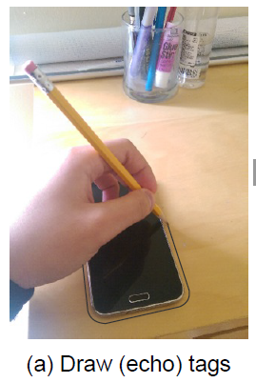
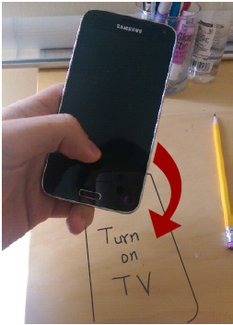
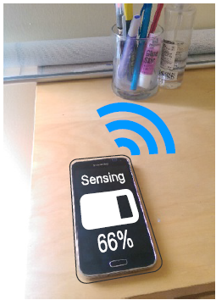
2.3 Acoustic/Ultrasound Signatures
[7] Y. Tung, K. Shin, EchoTag: Accurate Infrastructure-Free Indoor Location Tagging with Smartphones, Mobicom2015

Slide 5
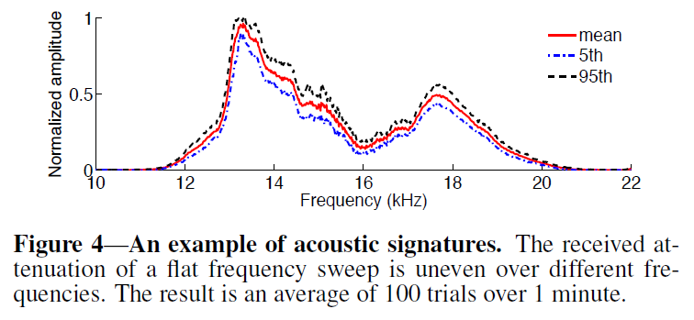
2.3 Acoustic/Ultrasound Signatures
[7] Y. Tung, K. Shin, EchoTag: Accurate Infrastructure-Free Indoor Location Tagging with Smartphones, Mobicom2015

Slide 6
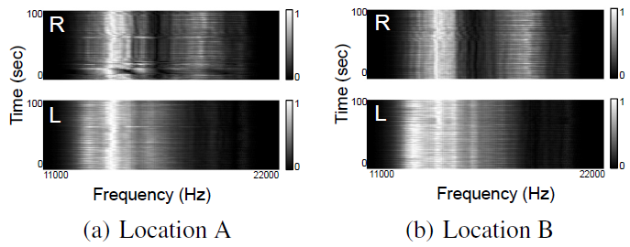
2.3 Acoustic/Ultrasound Signatures
Acoustic feature at different locations.

Slide 7
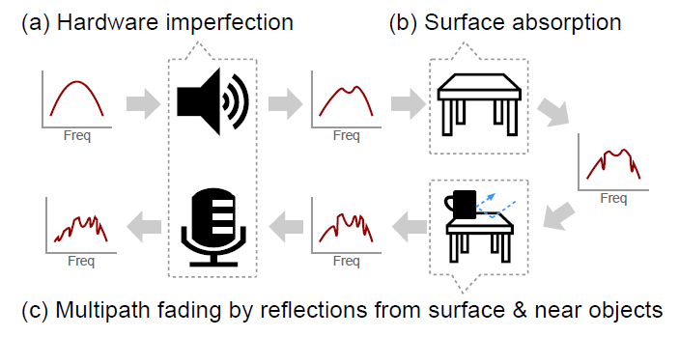
Why acoustic features are different at different locations?

Slide 8
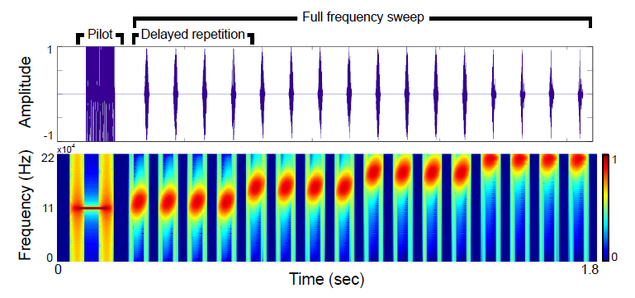
Sweeping Acoustic Signal

Slide 9
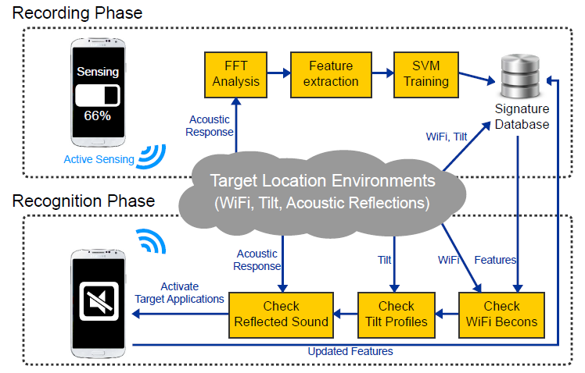
System Architecture

Slide 10
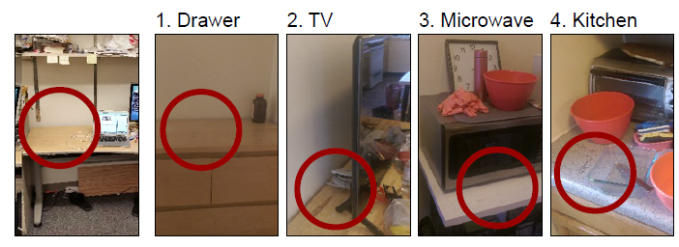
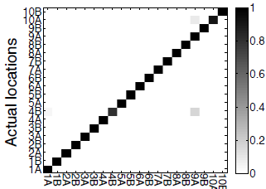
Results

Slide 11
Fingerprint based on Acoustic Background Features

Slide 12
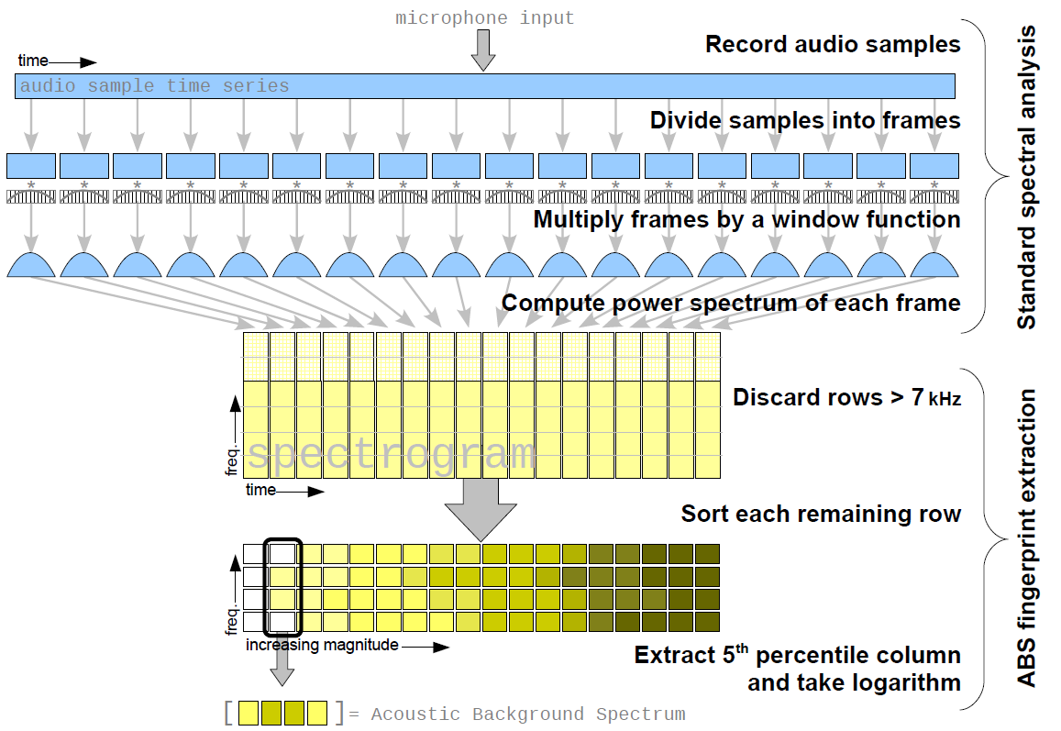
Acoustic Background Spectrum (ABS)
Tarzia, Stephen P., et al. "Indoor localization without infrastructure using the acoustic background spectrum.“ Mobisys2011.

Slide 13
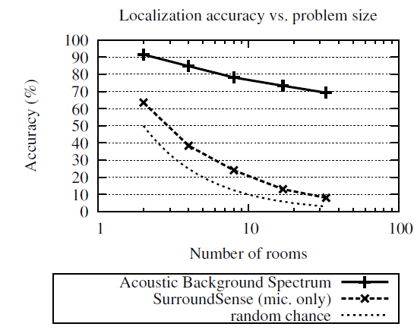
Classification Results

Slide 14
Indoor localization by visible light
Luxapose, Indoor Positioning with Mobile Phones and Visible Light (Mobicom14)
LiTell: Robust Indoor Localization Using Unmodified Light Fixtures (Mobicom16)

Slide 15
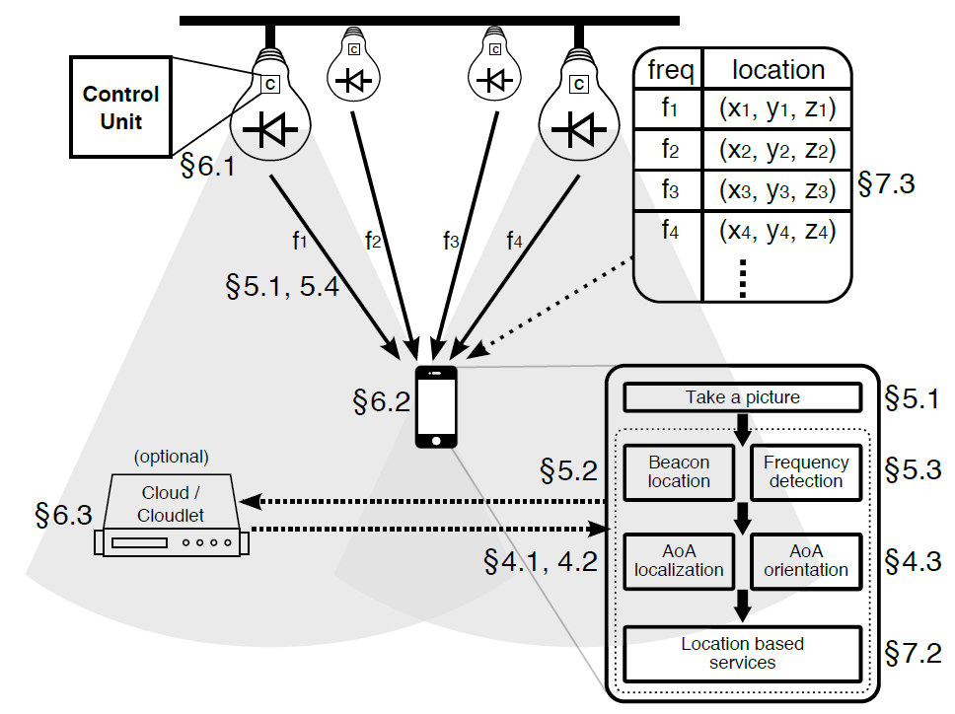
Localization by Visible Light
System architecture
Kuo Y S, Pannuto P, Hsiao K J, et al. Luxapose: Indoor positioning with mobile phones and visible. Mobicom2014, 447-458.

Slide 16
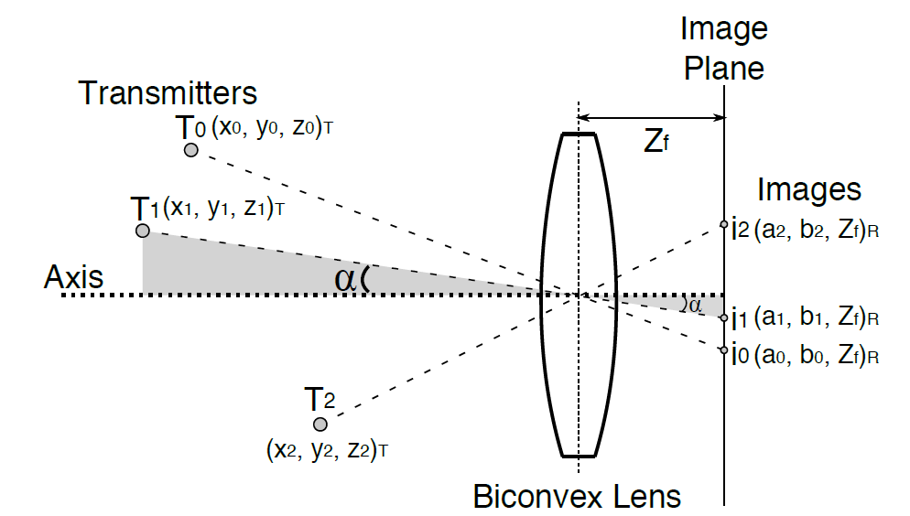
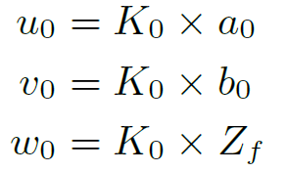
Optical AOA Localization
Transmitter’s location in receiver’s frame

Slide 17
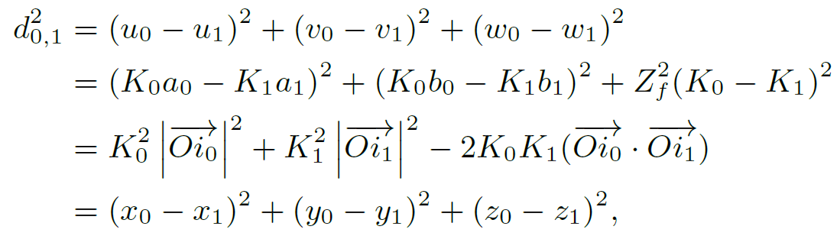
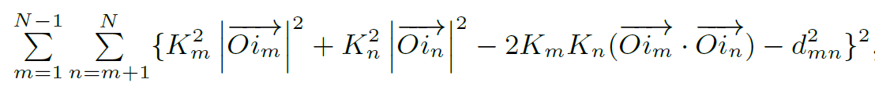
Distance holds in two frames
LSQ to calculate all scaling factors

Slide 18
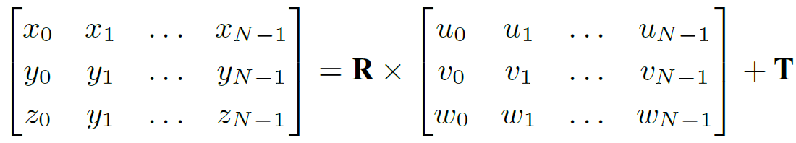
Locating the Receiver in the Global Frame
T: the location of the receiver
R: the pose of the receiver

Slide 19
How to derive the location T?

Slide 20
How to determine R?
T is known
R can be derived by solving LSQ problem

Slide 21
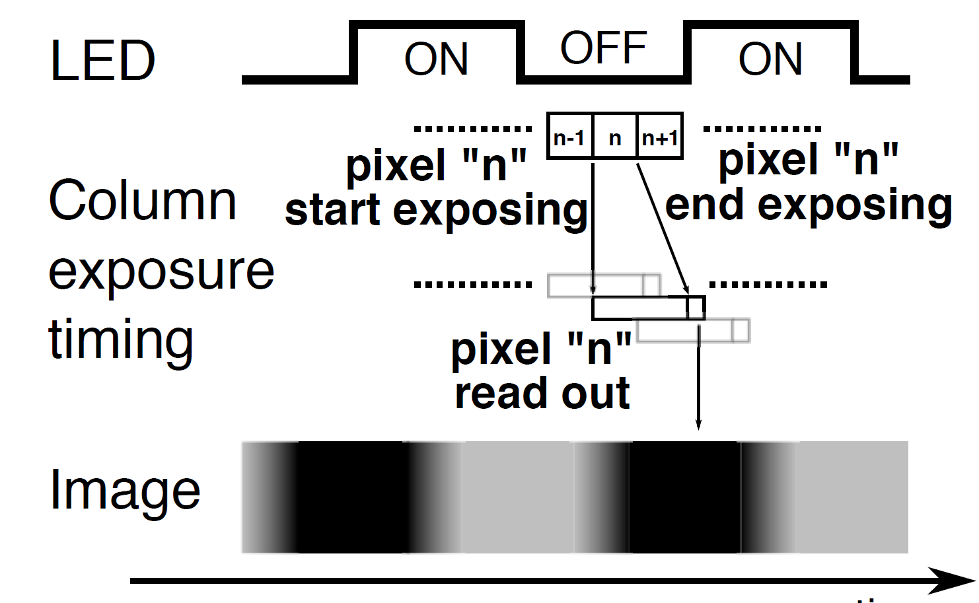
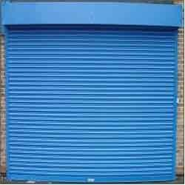
Rolling shutter Effect of CMOS Camera
The pixels are rolling during exposing.

Slide 22
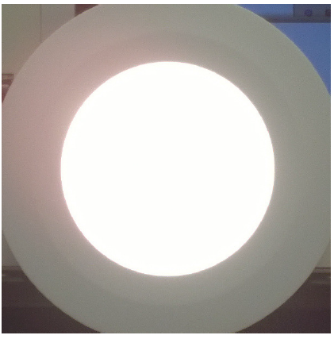
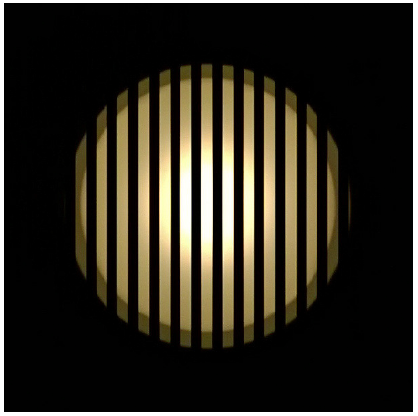
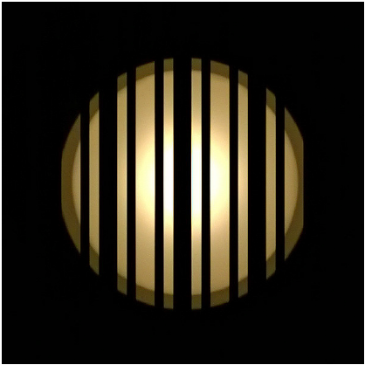
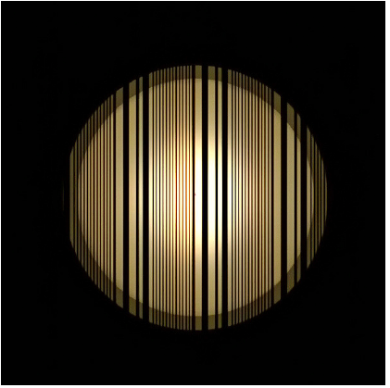
Capture the codes of light
Cannot capture in auto expose
Capture light codes in fast expose
Capture Manchester codes
Capture hybrid codes

Slide 23
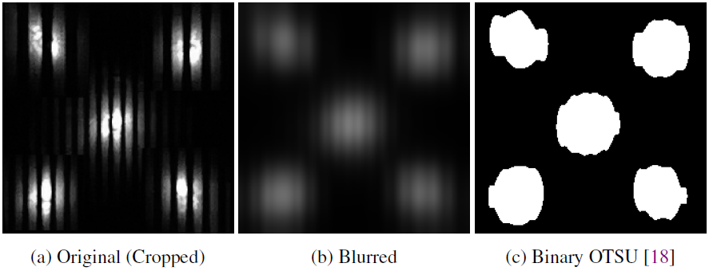
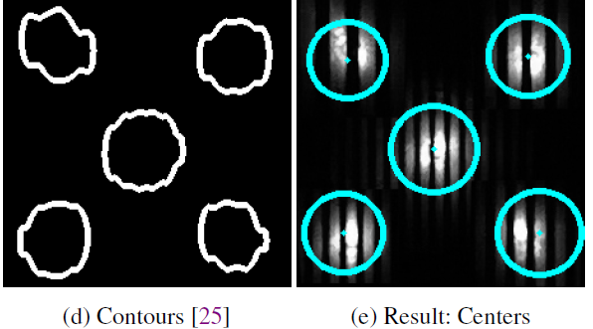
Finding Light Center

Slide 24
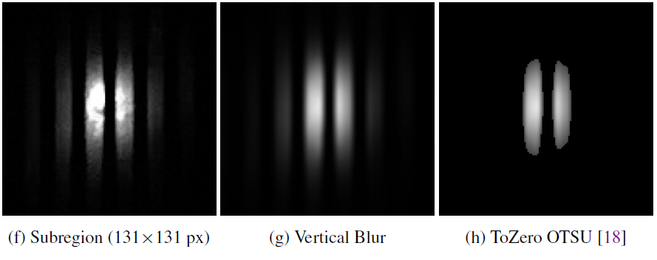
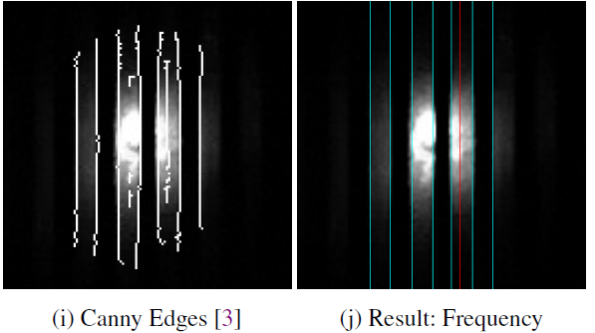
Reading Light Codes

Slide 25
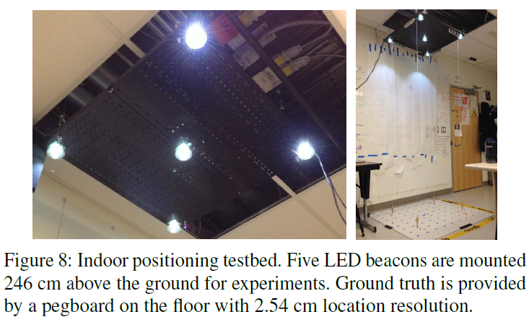
Testbed

Slide 26
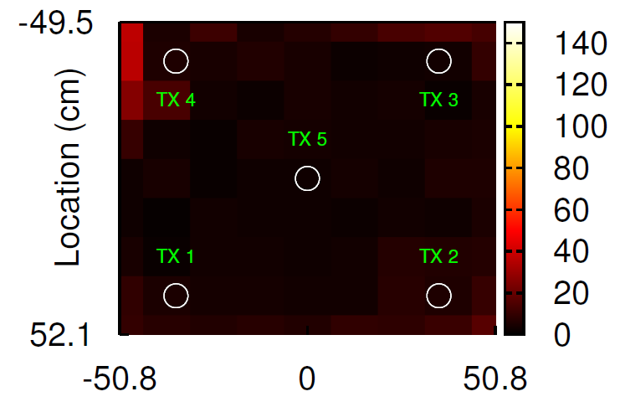
Localization accuracy

Slide 27
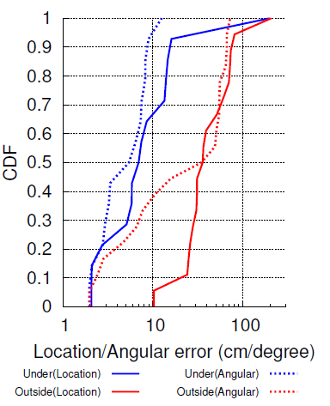
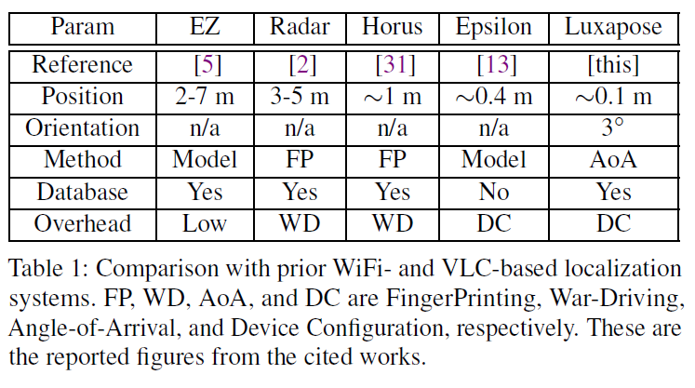
Localization accuracy

Slide 28
Indoor localization by WiFi Channel State Information

Slide 29
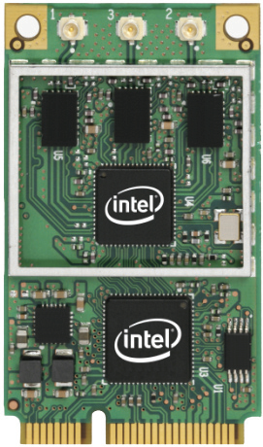
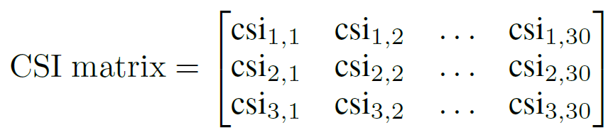
WiFi Imaging
http://dhalperi.github.io/linux-80211n-csitool/#overview
Can measure the composed channel state information in 30 sub-channels

Slide 30
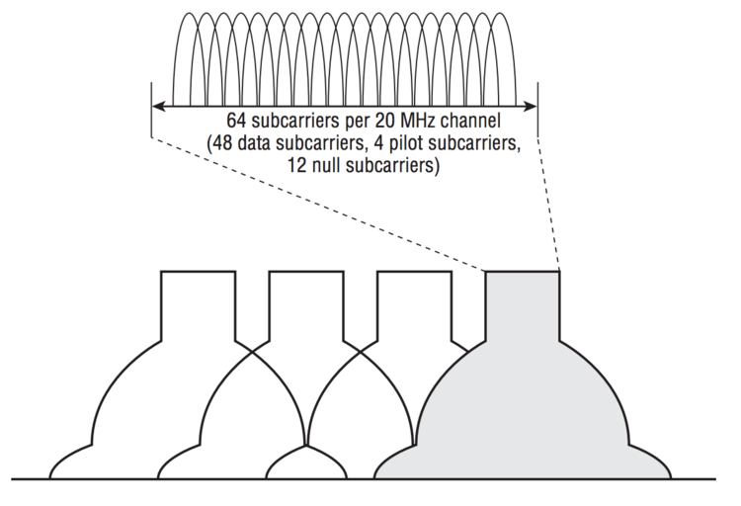
WiFi OFDM subcarriers

Slide 31
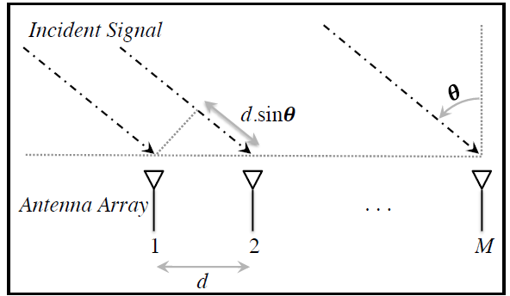
Calculate AOA and TOF of RF

Slide 32
Calculate RF AOA
The phase shift introduced at the m^{th} antenna by the kth path:
Let:
The measurement vector by the array for the kth path

Slide 33
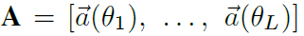
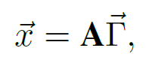
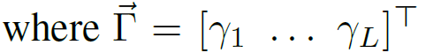
Calculate RF AOA
Suppose there are L paths
Signal composition from multiple paths
M*L
is attenuation vector of k paths
M*1

Slide 34
Calculate RF AOA
In OFDM, data is transmitted over multiple subcarriers each with different frequency.

Slide 35
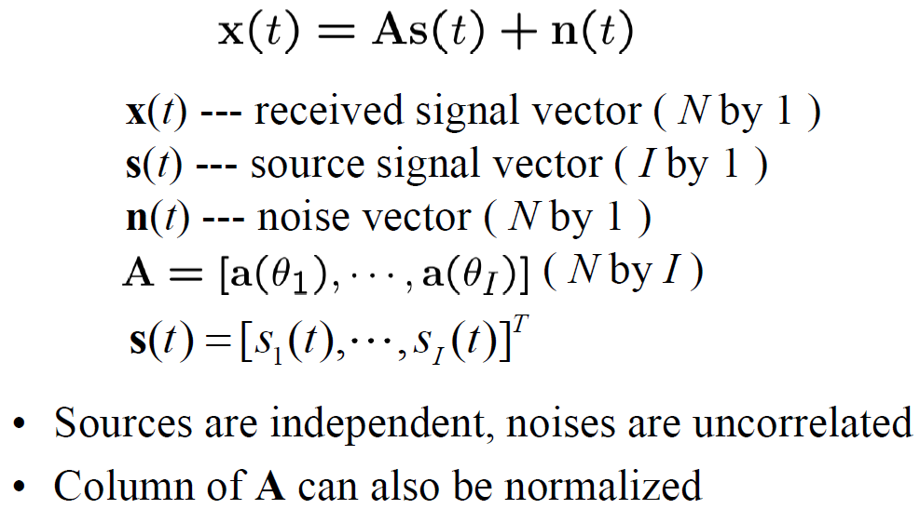
Music Algorithm [Schmidt 1986]
If there are I sources signals received by the array,

Slide 36
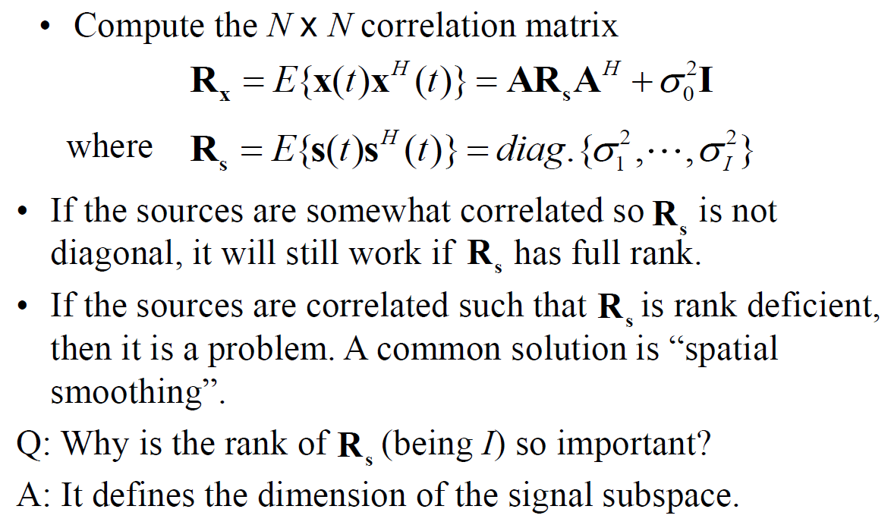
The music algorithm

Slide 37
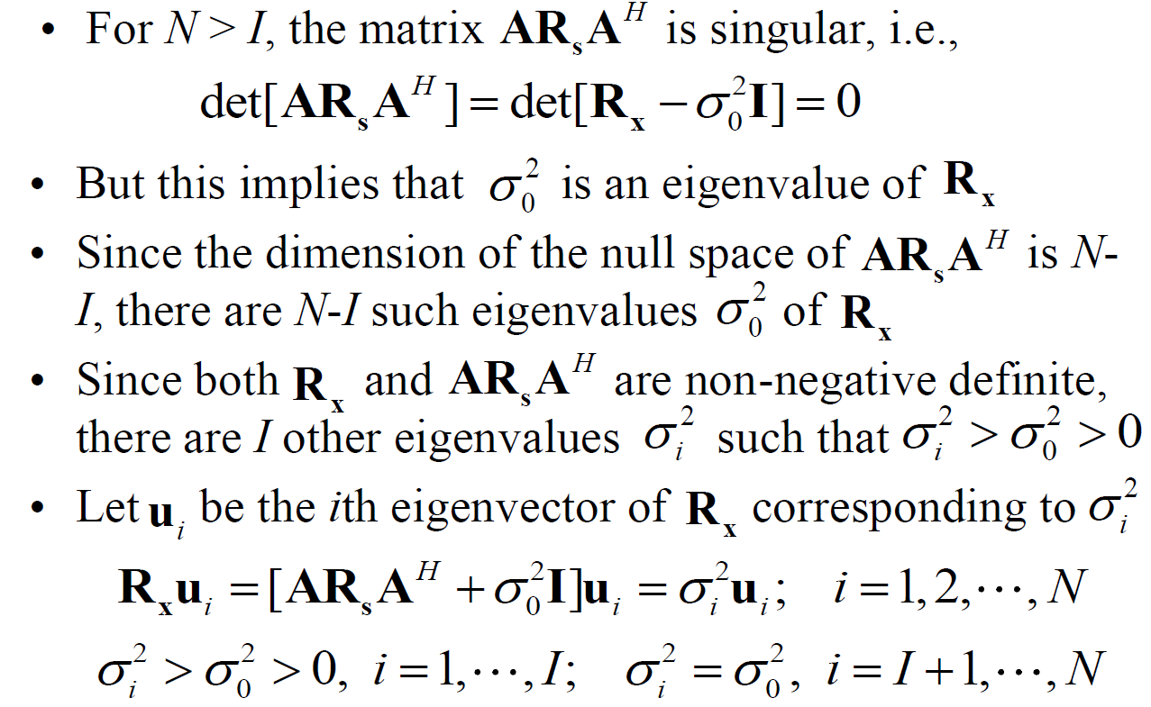
The music algorithm

Slide 38
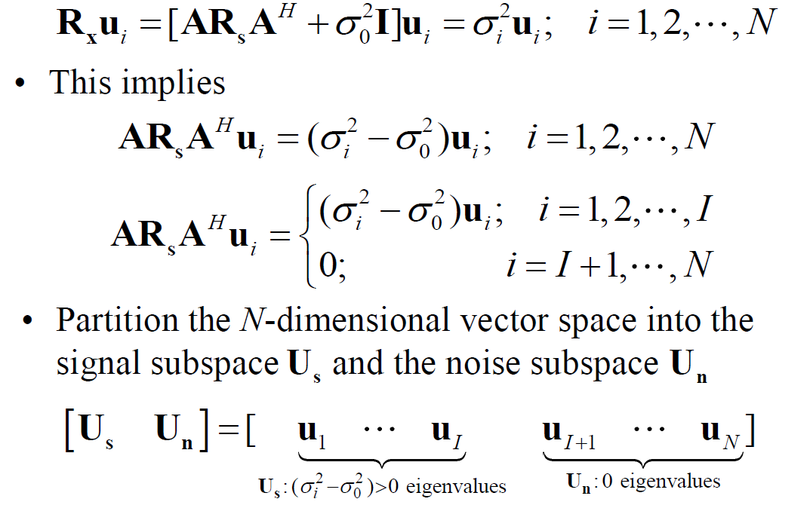
The music algorithm

Slide 39
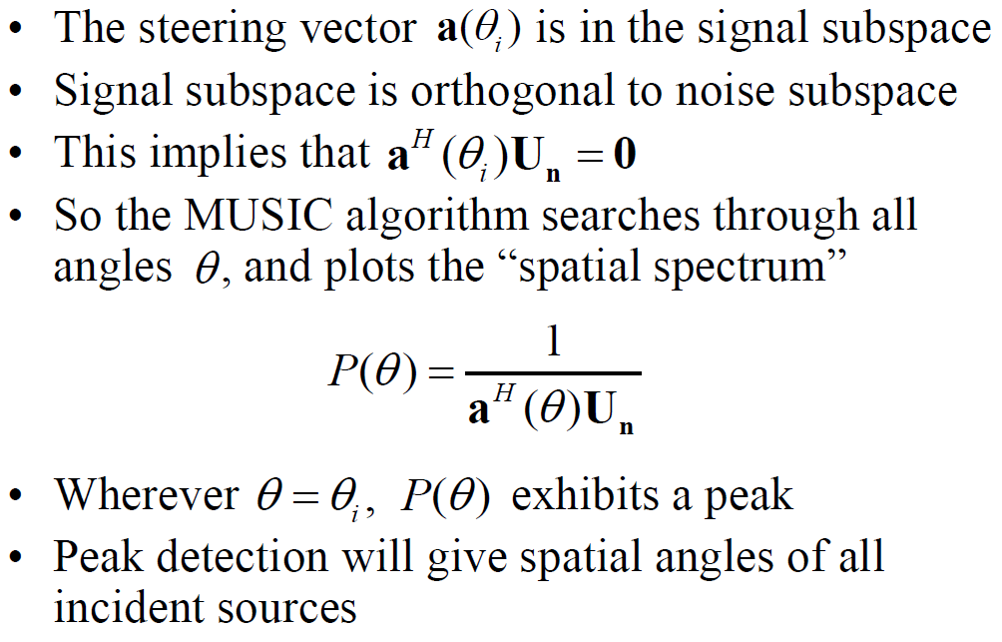
The music algorithm

Slide 40
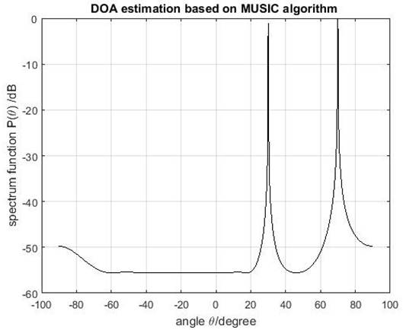
The music algorithm

Slide 41
Related Research Works
Using the RF AOA as fingerprint
Calculate AOA and TOF
Find the direct path and to localize by AOA
Reducing the number of antenna
Using motion of mobile phone to simulate an antenna array.
WiFi Imaging

Slide 42
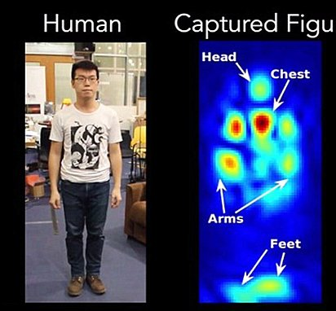
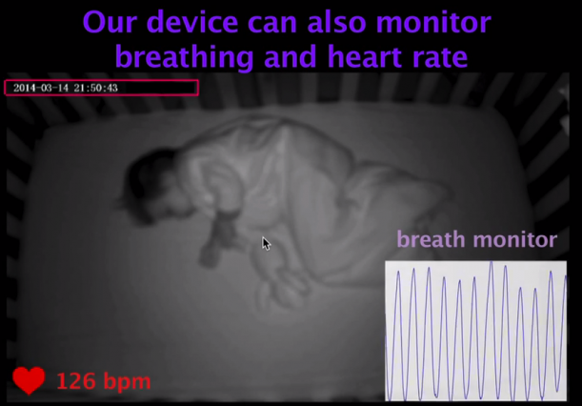
WiFi Imaging [MIT, Dinna Kataby]

Slide 43
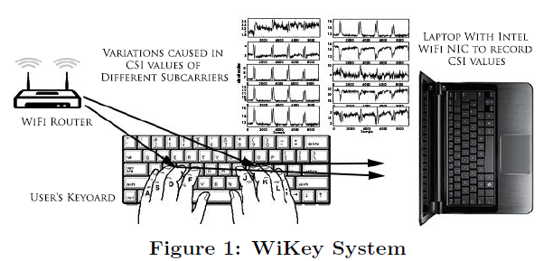
WiKey, mobicom15, U Michigan

Slide 44
Indoor Localization by Crowdsourcing and unsupervised learning
1. crowdsourcing 2. unsupervised learning

Slide 45
Localization by Crowdsourcing
Rai A, Chintalapudi K K, Padmanabhan V N, et al. Zee: zero-effort crowdsourcing for indoor localization, Mobicom 2012: 293-304.
Zheng Yang, Chenshu Wu, and Yunhao Liu, "Locating in Fingerprint Space: Wireless Indoor Localization with Little Human Intervention", (PDF), ACM MobiCom 2012, Istanbul, Turkey, August 22-26, 2012.
Chenshu Wu, Zheng Yang, Yunhao Liu, "Smartphones Based Crowdsourcing for Indoor Localization", (PDF), IEEE Transactions on Mobile Computing (TMC), Vol. 14, Issue 2,February, 2015, Pages 444-457.
Xinglin Zhang, Zheng Yang, Chenshu Wu, Wei Sun, Yunhao Liu, Kai Liu, "Robust Trajectory Estimation for Crowdsourcing-Based Mobile Applications", IEEE Transactions on Parallel and Distributed Systems (TPDS), Vol. 25, No. 7, July 2014, Pages 1876-1885.
Ruipeng Gao, Mingmin Zhao, Tao Ye, Fan Ye, Yizhou Wang, Kaigui Bian, Tao Wang, and Xiaoming Li. 2014. Jigsaw: indoor floor plan reconstruction via mobile crowdsensing. (MobiCom '14). ACM, New York, NY, USA, 249-260.

Slide 46
Localization by Unsupervised Learning
Wang H, Sen S, Elgohary A, et al. No need to war-drive: unsupervised indoor localization. MobiSys, 2012: 197-210.
Moustafa Alzantot and Moustafa Youssef. 2012. CrowdInside: automatic construction of indoor floorplans. (SIGSPATIAL '12). ACM, New York, NY, USA, 99-108.
Yifei Jiang, Xin Pan, Kun Li, Qin Lv, Robert P. Dick, Michael Hannigan, and Li Shang. 2012. ARIEL: automatic wi-fi based room fingerprinting for indoor localization. (UbiComp '12). ACM, New York, NY, USA, 441-450.
Bao X, Liu B, Tang B, et al. PinPlace: associate semantic meanings with indoor locations without active fingerprinting, Ubicomp. 2015: 921-925.
Tachikawa M, Maekawa T, Matsushita Y. Predicting location semantics combining active and passive sensing with environment-independent classifier, ubicomp2016. ACM, 2016: 220-231.

Slide 47
Timeline of localization by crowdsourcing and unsupervised learning
Robust CS, TMC
ZEE, Mobicom
Crowdsourcing
LiFS, Mobicom
Jigsaw Mobicom
Crowdsourcing
TMC
WILL, Infocom
2012
2014
2015
2016
No need for war drive, Mobisys
Predicting location semantics, ubicomp2016
Crowdinside, sigspatial
Pinplace, ubicomp2015
ARIEL, uibcomp
Unsupervised learning
2012
2014
2015
2016

Slide 48
Homework (Due in Dec. 14)
Review the most related work of your project (submitting a ppt.).
Give detailed introduction to around 3 most related papers
Draw a time line of the related work.
Discuss the unsolved problems.

